Slide 1
TINC
양희림/서장원/장하영/최진경

Slide 2
Table of Contents
Goal
Description
Features &
Contents
Demo
Member
information
Role

Slide 3


Main Goal
Creative
Fun
Think,
Enhanced
Play with
Man,Women,
Child, Old

Slide 4


Description of Project
TINC
“ is a GAME that a user guess the answers
By a combination of pictures “

Slide 5
Features & Contents

Slide 6

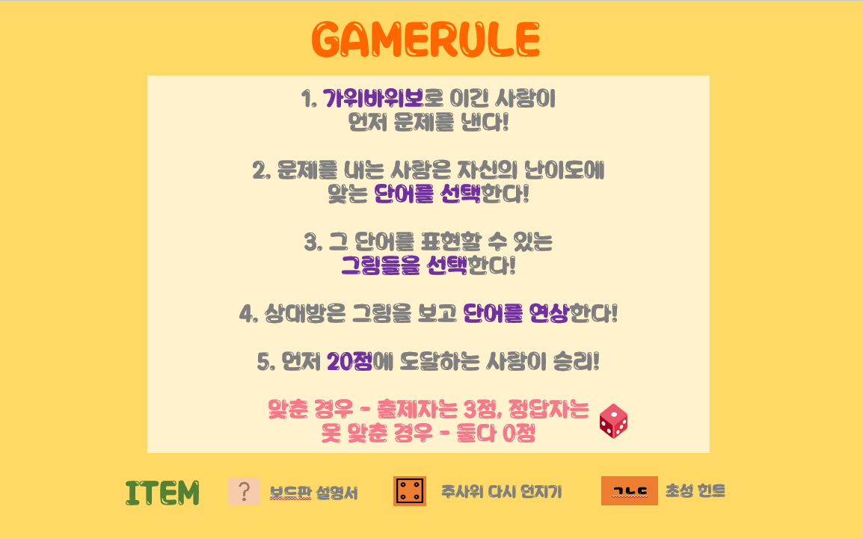
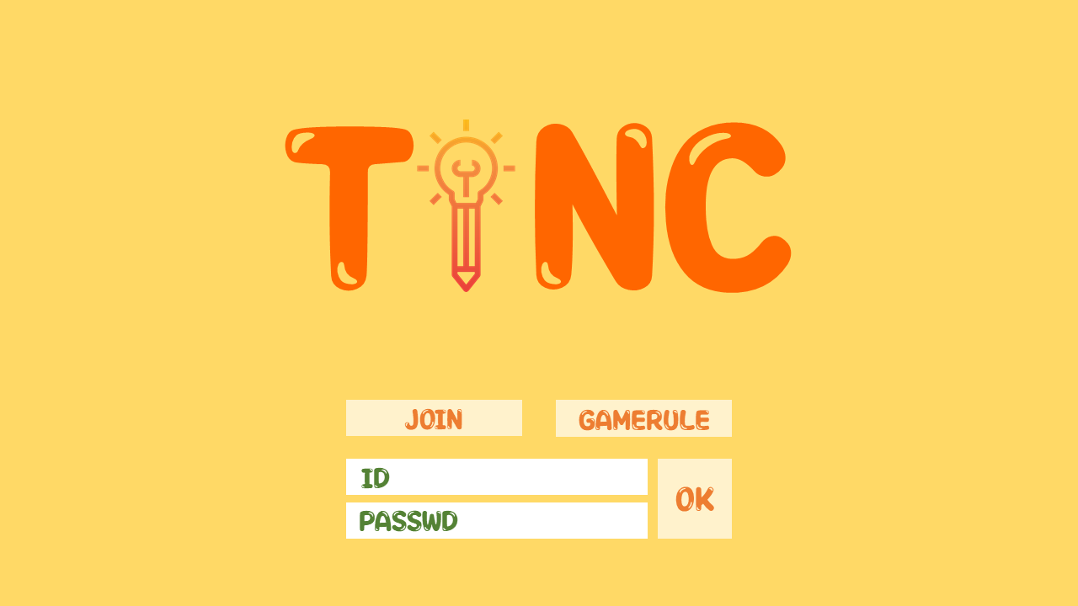

Main Screen

Slide 7
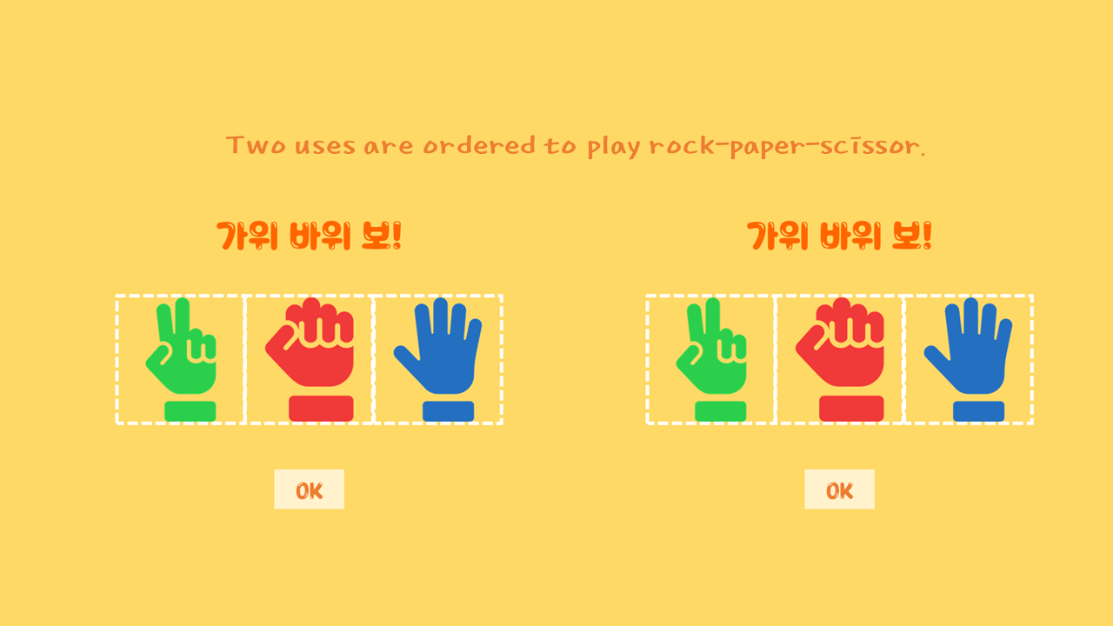
Choose Player

Slide 8
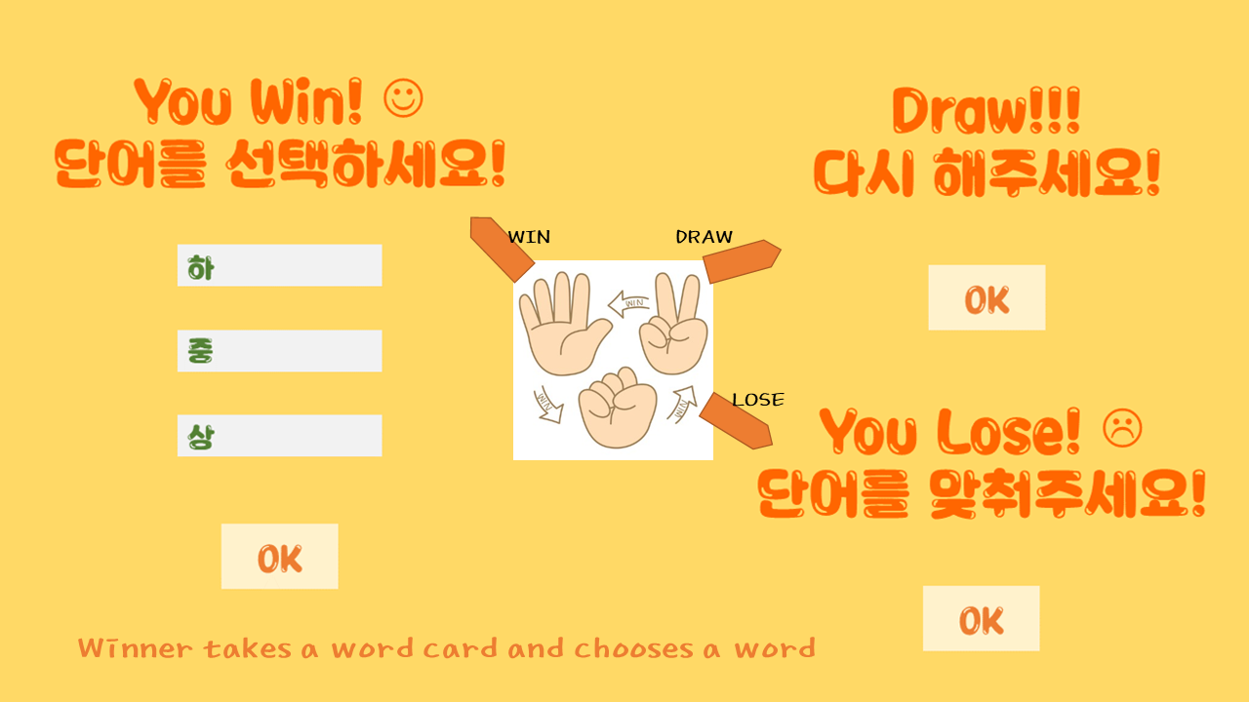
Choose Player & Card
Titanic

Slide 9
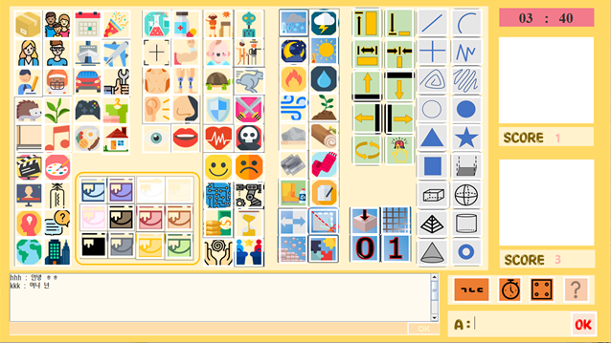
Main Screen
<-Timer
<-Score
movie
<-Item
<-
<-
Chat
Answer

Slide 10
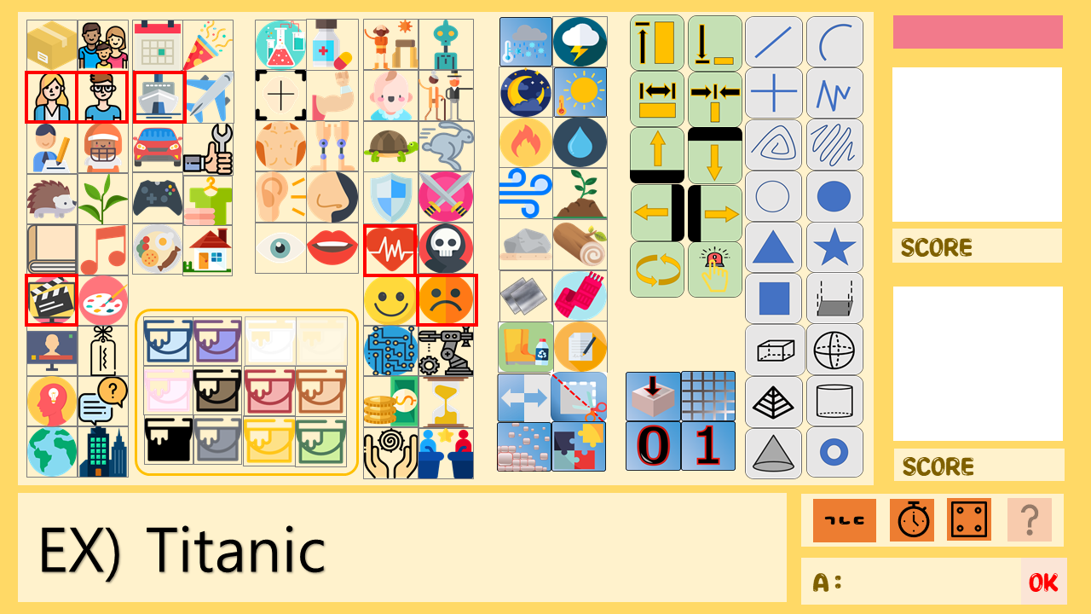


Example
Titanic

Slide 11


Example
+4
+3
Titanic

Slide 12
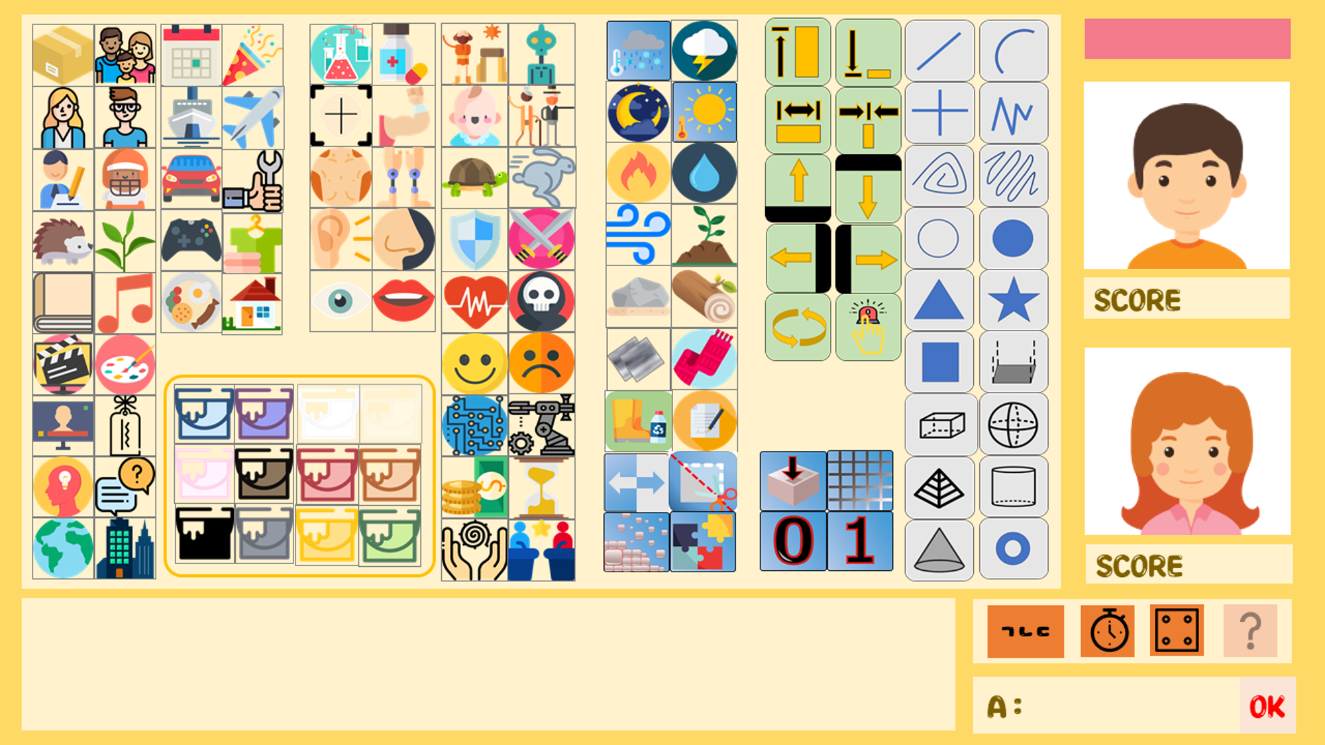

End Game
<-20 Points!
20
Titanic

Slide 13
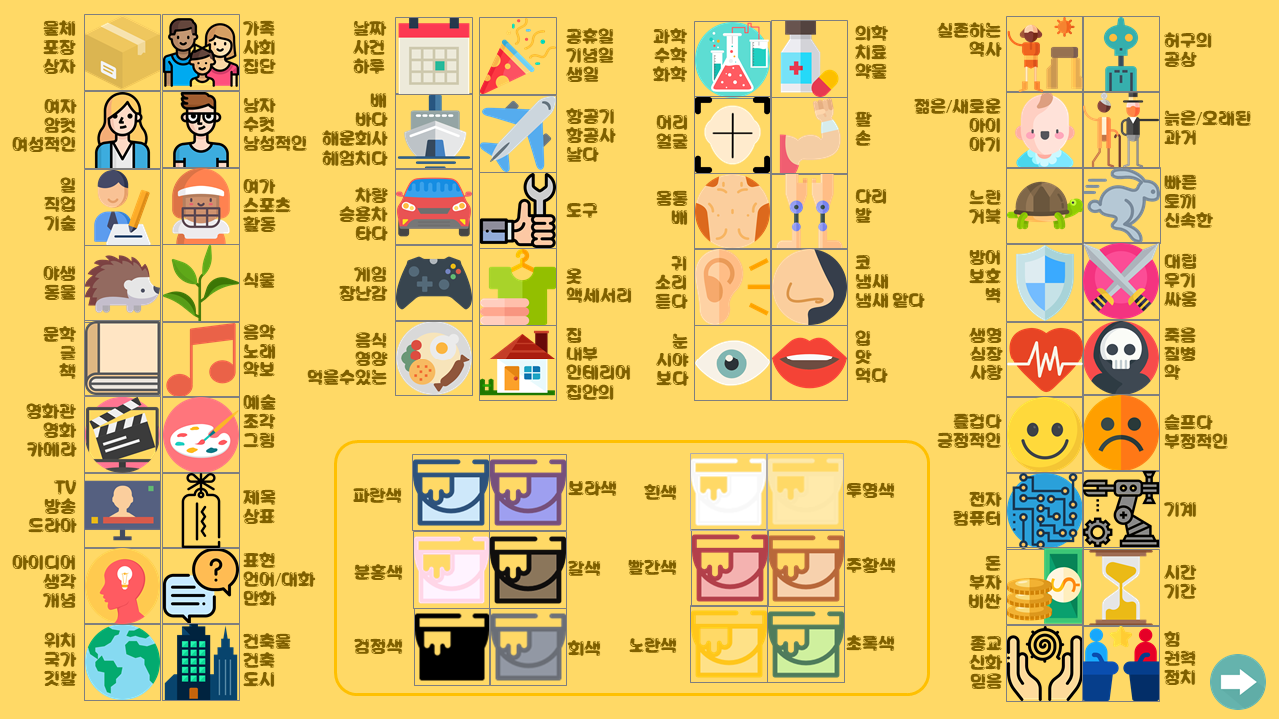
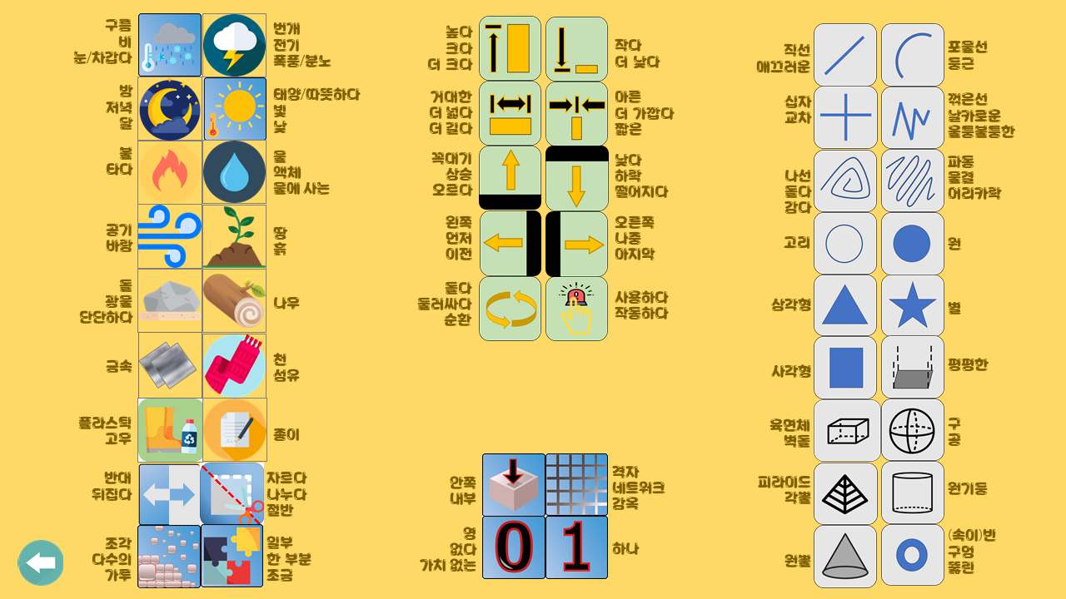
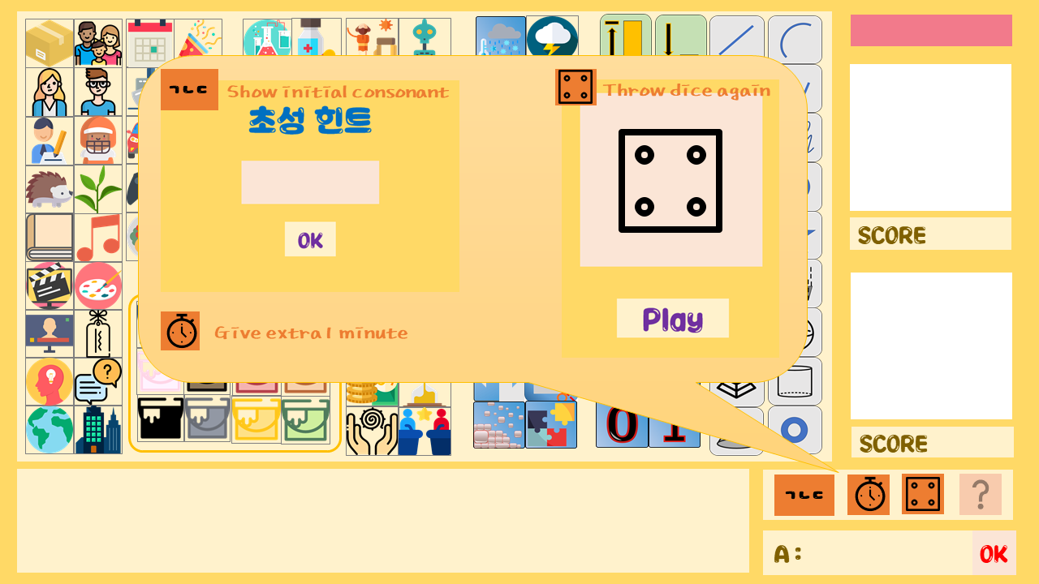
Item Information

Slide 14
Demo
https://www.youtube.com/watch?v=YQJT0EiYkAU

Slide 15
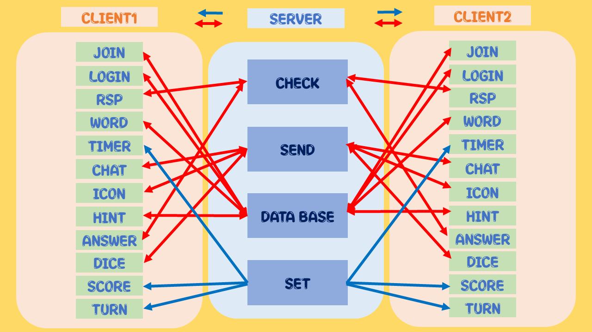
Socket Programming

Slide 16

Technology
G.U.I – JAVA swing
Chat service – socket programming
for multithread
DataBase – Use JDBC

Slide 17




Member Role
Seo Jang Won
Create Game board
&Item,
GIT Page
Yang Hee Rim
Socket ,
Chatting,
Login
Jang Ha Yeong
DataBase,
Join,
Socket
Choi Jin Kyung
GUI Design
RSP code,
Timer

Slide 18
Thank you
서장원/양희림/장하영/최진경

